Slide 1

UNIVERSITY INSTITUTE OF ENGINEERING
COMPUTER SCIENCE ENGINEERING
ARTIFICIAL INTELLIGENCE
(23 CSH - 621)
INTRODUCTION
DISCOVER . LEARN . EMPOWER

Slide 2
Agent Types
Types of agents (increasing in generality and ability to handle complex environments)
Simple reflex agents
Reflex agents with state
Goal-based agents
Utility-based agents
Learning agent

Slide 3
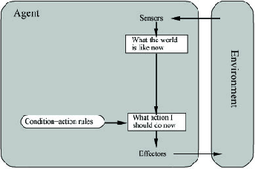
Simple Reflex Agent
Use simple “if then” rules
Can be short sighted
SimpleReflexAgent(percept)
state = InterpretInput(percept)
rule = RuleMatch(state, rules)
action = RuleAction(rule)
Return action

Slide 4
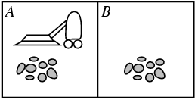
Example: Vacuum Agent
Performance?
1 point for each square cleaned in time T?
#clean squares per time step - #moves per time step?
Environment: vacuum, dirt, multiple areas defined by square regions
Actions: left, right, suck, idle
Sensors: location and contents
[A, dirty]
Rational is not omniscient
Environment may be partially observable
Rational is not clairvoyant
Environment may be stochastic
Thus Rational is not always successful

Slide 5
Reflex Vacuum Agent
If status=Dirty then return Suck
else if location=A then return Right
else if location=B then right Left

Slide 6
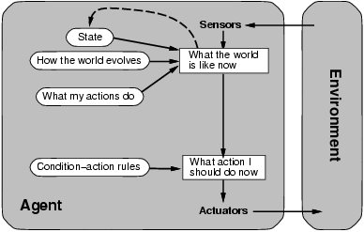
Reflex Agent With State
Store previously-observed information
Can reason about unobserved aspects of current state
ReflexAgentWithState(percept)
state = UpdateDate(state,action,percept)
rule = RuleMatch(state, rules)
action = RuleAction(rule)
Return action

Slide 7
Reflex Vacuum Agent
If status=Dirty then Suck
else if have not visited other square in >3 time units, go there

Slide 8
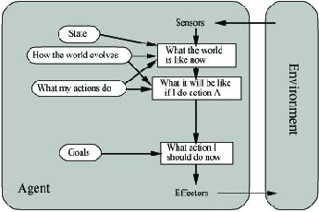
Goal-Based Agents
Goal reflects desires of agents
May project actions to see if consistent with goals
Takes time, world may change during reasoning

Slide 9
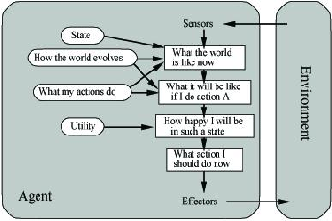
Utility-Based Agents
Evaluation function to measure utility f(state) -> value
Useful for evaluating competing goals

Slide 10
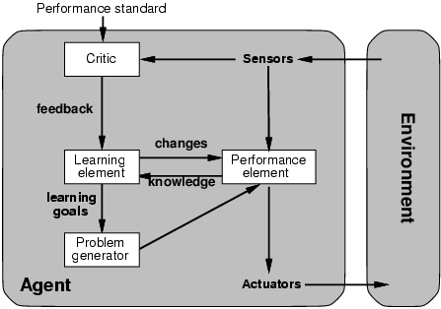
Learning Agents

Slide 11
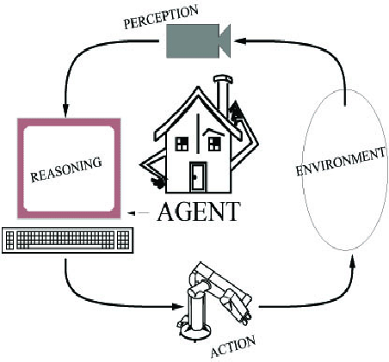
Xavier mail delivery robot
Performance: Completed tasks
Environment: See for yourself
Actuators: Wheeled robot actuation
Sensors: Vision, sonar, dead reckoning
Reasoning: Markov model induction, A* search, Bayes classification

Slide 12
Pathfinder Medical Diagnosis System
Performance: Correct Hematopathology diagnosis
Environment: Automate human diagnosis, partially observable, deterministic, episodic, static, continuous, single agent
Actuators: Output diagnoses and further test suggestions
Sensors: Input symptoms and test results
Reasoning: Bayesian networks, Monte-Carlo simulations

Slide 13
TDGammon
Performance: Ratio of wins to losses
Environment: Graphical output showing dice roll and piece movement, fully observable, stochastic, sequential, static, discrete, multiagent
World Champion Backgammon Player
Sensors: Keyboard input
Actuator: Numbers representing moves of pieces
Reasoning: Reinforcement learning, neural networks

Slide 14
Factory Floor Scheduling
Performance:
Environment:
Actuators: Ordering of tasks
Sensors: Assembly tree, Bill of materials
Reasoning: Constraint satisfaction, nonlinear and hierarchical planning, genetic algorithms, search

Slide 15
Alvinn
Performance: Stay in lane, on road, maintain speed
Environment: Driving Hummer on and off road without manual control (Partially observable, stochastic, episodic, dynamic, continuous, single agent), Autonomous automobile
Actuators: Speed, Steer
Sensors: Stereo camera input
Reasoning: Neural networks

Slide 16
Talespin
Performance: Entertainment value of generated story
Environment: Generate text-based stories that are creative and understandable
One day Joe Bear was hungry. He asked his friend Irving Bird where some honey was. Irving told him there was a beehive in the oak tree. Joe threatened to hit Irving if he didn't tell him where some honey was.
Henry Squirrel was thirsty. He walked over to the river bank where his good friend Bill Bird was sitting. Henry slipped and fell in the river. Gravity drowned. Joe Bear was hungry. He asked Irving Bird where some honey was. Irving refused to tell him, so Joe offered to bring him a worm if he'd tell him where some honey was. Irving agreed. But Joe didn't know where any worms were, so he asked Irving, who refused to say. So Joe offered to bring him a worm if he'd tell him where a worm was. Irving agreed. But Joe didn't know where any worms were, so he asked Irving, who refused to say. So Joe offered to bring him a worm if he'd tell him where a worm was…
Actuators: Add word/phrase, order parts of story
Sensors: Dictionary, Facts and relationships stored in database
Reasoning: Planning

Slide 17
Robot Soccer
Robot soccer competition
Sensors: Camera image, messages from other players
Reasoning: Planning, image processing
Action: Robot 2D move or kick ball

Slide 18
Webcrawler Softbot
Search web for items of interest
Perception: Web pages
Reasoning: Pattern matching
Action: Select and traverse hyperlinks

Slide 19
Other Example AI Systems
Translation of Caterpillar truck manuals into 20 languages
Shuttle packing
Military planning (Desert Storm)
Intelligent vehicle highway negotiation
Credit card transaction monitoring
Billiards robot
Juggling robot
Credit card fraud detection
Lymphatic system diagnoses
Mars rover
Sky survey galaxy data analysis

Slide 20
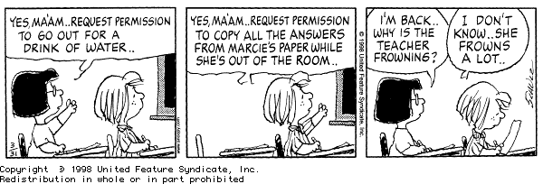
Other Example AI Systems
Knowledge Representation
Search
Problem solving
Planning
Machine learning
Natural language processing
Uncertainty reasoning
Computer Vision
Robotics

Slide 21
THANK YOU

